Slide 1
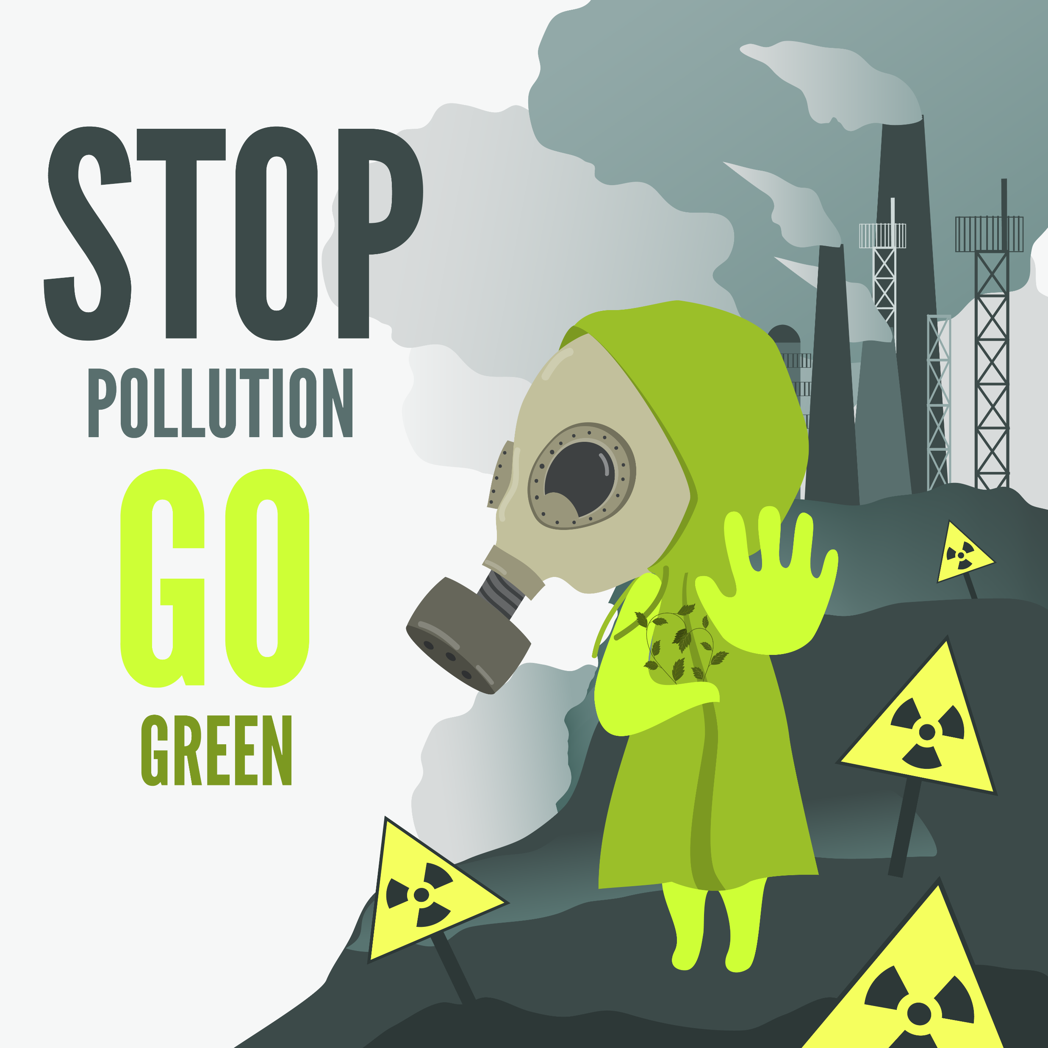
The Health Impacts and Mortality Risk of Air Pollution
Team - 13
Farman Syed
Marivic Tanguin
Ali Heidari.
Sameen Shahzad
Team Member

Slide 2
PROJECT DESCRIPTION
Purpose
The purpose of this study is to investigate the health impacts and mortality risk of air pollution, including ambient household air pollution, ambient particulate matter pollution, ambient ozone pollution, and air pollution caused by solid fuels. By examining exposure to these types of pollution, we aim to gain a better understanding of the risks associated with air pollution and identify potential strategies to mitigate its harmful effects on human health.
Scope
Limitations
The study covers a period of 5 years (2015-2019) and includes data on air quality, mortality rates, and disease burden associated with air pollution from a variety of countries and regions. The focus is on the health impacts and mortality risk associated with exposure to different type of air pollution.
The study is limited by the availability and quality of data, which may vary by country and over time. In addition, the study focuses on selected types of air pollution and does not cover all possible sources of air pollution, such as industrial emissions or transportation-related pollution.

Slide 3
RESEARCH QUESTIONS
Ambient Air Quality Data
Disease burden by Risk Factor
The analysis focuses on the air quality levels, specifically PM25, PM10, and NO2, in the top 10 countries
The analysis involves comparing the Disability-Adjusted Life Years (DALY) attributed to various diseases
25%
AQ Pollution Mortality Data
Number of death by Risk factors
25%
The analysis compares the causes of death due to different types of pollution with the impact of air pollution
The analysis compares the causes of death due to various diseases with the impact of air pollution in the top 10 countries
25%
Outdoor Pollution Rates by Ages
Death Rates from Air pollution
The analysis focuses on the top 10 countries where air pollution is a leading cause of death across different age groups, with the aim of determining whether it disproportionately affects either the young or the old
The analysis examines the top 10 countries where air pollution is a major cause of death, categorized by the type of air pollution, such as household pollutants or ozone
25%

Slide 4
DATA EXPLORATION
& CLEANING
We have gathered the data by web scraping, through API requests and manual downloads from the following resources:
World Health Organization (WHO)
Global Alliance on Health and Pollution (GAHP)
kaggle.com
For Data Cleaning we used Python & Jupyter Notebook

Slide 5
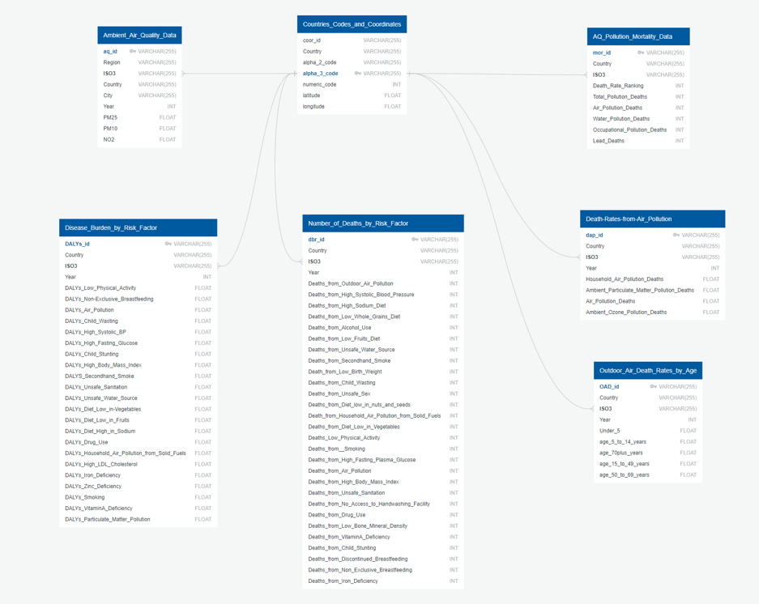
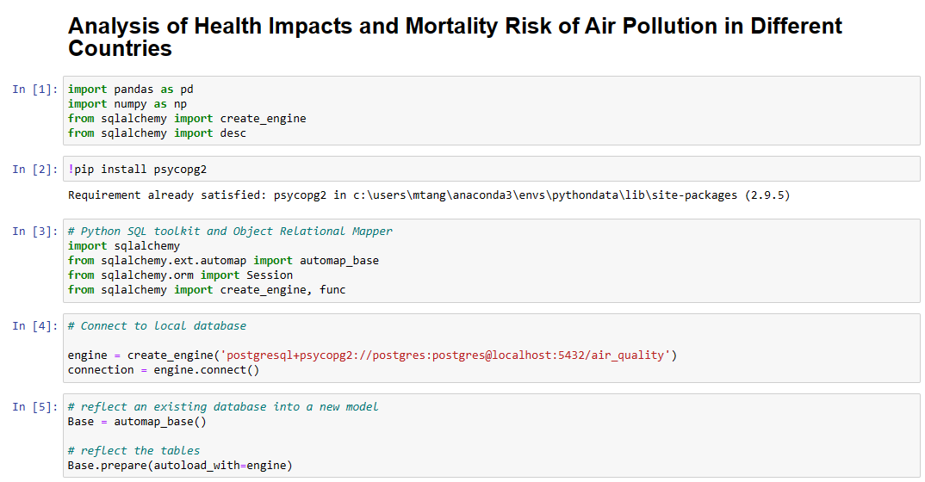
DATA BASE MANAGEMENT
We use PostgreSQL as a database management system for storing data in our web applications, and to connect to it using a Python Flask API.

Slide 6
DEMO

Slide 7
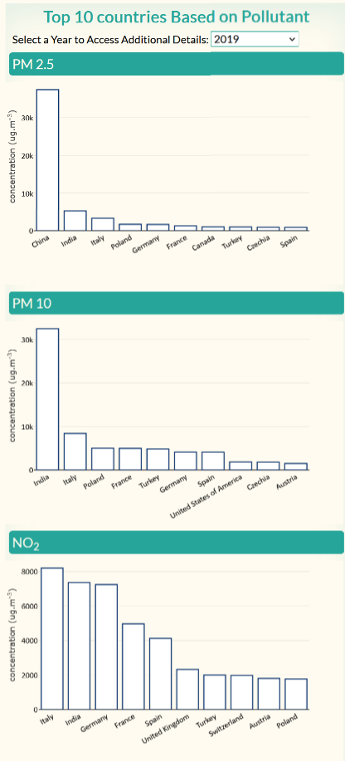
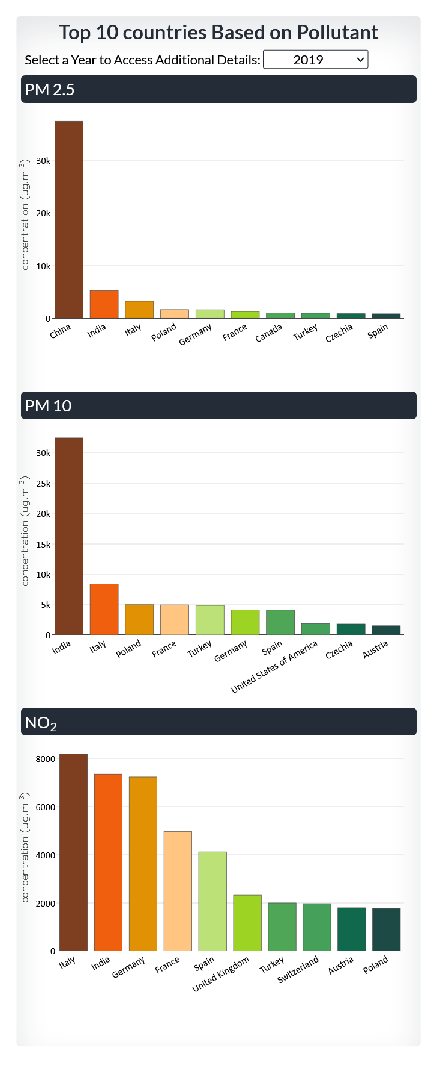
AMBIENT AIR QUALITY DATA
The analysis focuses on the air quality levels, specifically PM2.5, PM10, and NO2, in the top 10 countries, with the objective of evaluating the severity of air pollution in these countries
Particulate matter (PM) includes microscopic matter suspended in air or water. PM10 includes particles less than 10 µm(microns) in diameter, PM2.5 those less than 2.5 µm (microns). They can be emitted directly into the air from anthropogenic activities (industry, residential, agriculture, transport) and natural sources (forest fires, dust storms, sandstorms, volcanic eruptions, etc.).
Nitrogen dioxide, or NO2, is a gaseous air pollutant composed of nitrogen and oxygen NO2 forms when fossil fuels such as coal, oil, gas or diesel are burned at high temperatures.
Green City
Polluted City

Slide 8
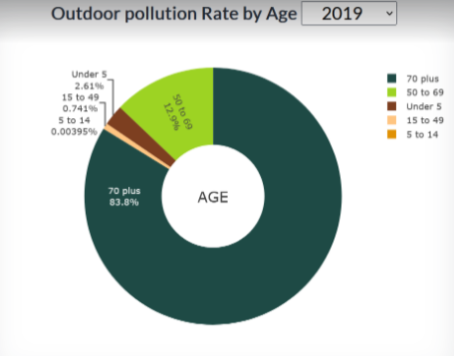
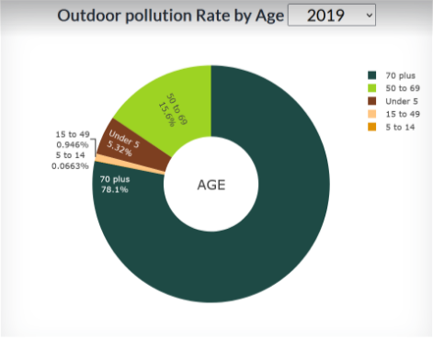

OUTDOOR POLLUTION RATES BY AGES
The analysis focuses on the top 10 countries where air pollution is a leading cause of death across different age groups, with the aim of determining whether it disproportionately affects either the young or the old.
Air pollution affects those that are most vulnerable the most. It is estimated that in 2021, the deaths of 40,000 children under the age of five were directly linked to PM2.5 air pollution.
CANADA
INDIA

Slide 9
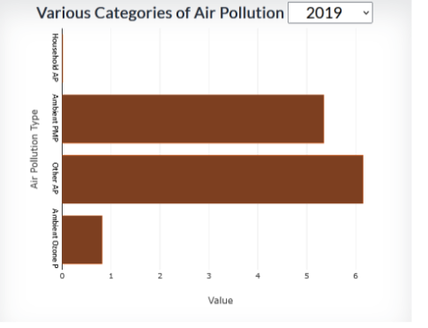
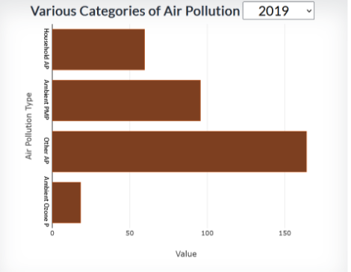
DEATH RATES FROM AIR POLLUTION
CANADA
The analysis examines countries where air pollution is a major cause of death, categorized by the type of air pollution, such as household pollutants or ozone, with the objective of gaining insights into the most harmful sources of air pollution in these countries.
INDIA

Slide 10
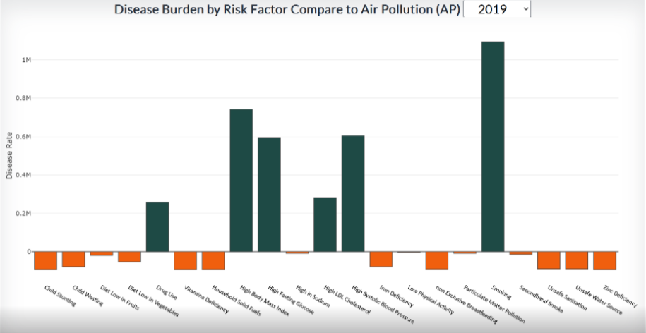
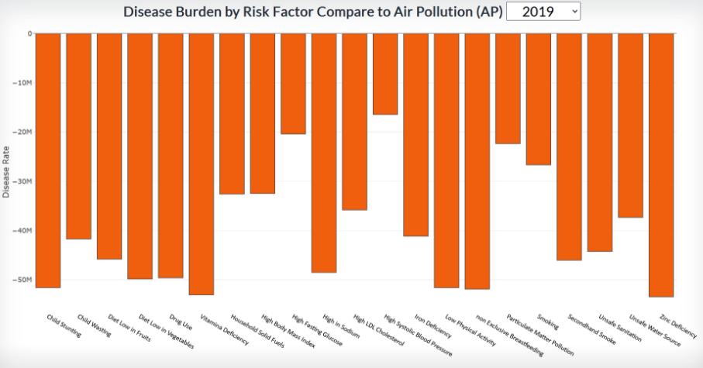
DISEASE BURDEN BY RISK FACTOR
CANADA
The analysis involves comparing the Disability-Adjusted Life Years (DALY) attributed to various diseases with the impact of air pollution in the top 10 countries, with the goal of understanding the potential association between air pollution DALYS compared to other risk factors in different countries like Smoking, Blood Pressure, Cholesterol, Fasting Glucose, Drug Use, Vitamin Deficiency, Iron Deficiency, High in Sodium, Low Vegetable and Fruit Diet, Zinc Deficiency
INDIA
INDIA

Slide 11
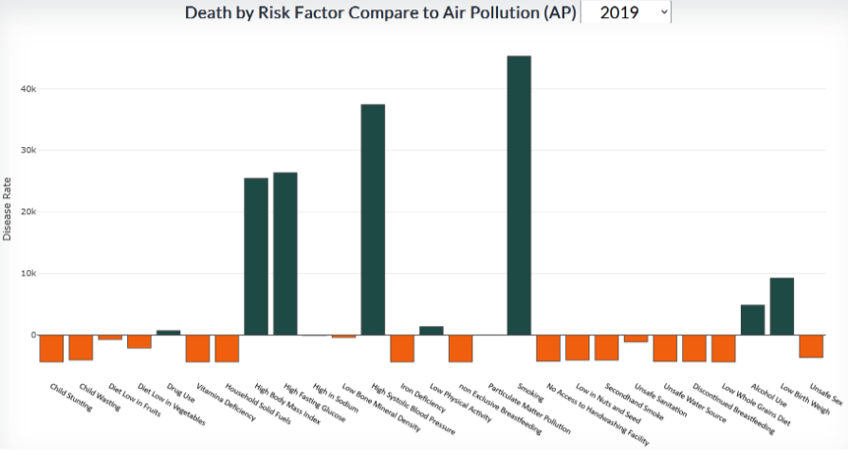
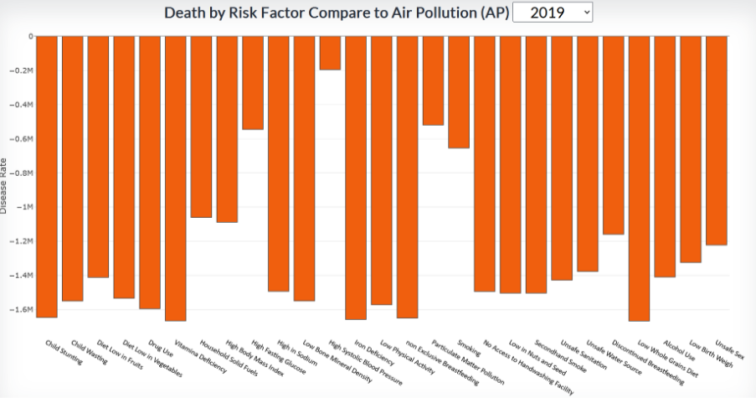
NUMBER OF DEATH BY RISK FACTORS
CANADA
The analysis compares the causes of death due to various diseases with the impact of air pollution in the top 10 countries, with the aim of identifying any potential correlation between air pollution and mortality rates from different diseases in these countries.
Air pollution causes and aggravates many diseases, ranging from asthma to cancer, lung illnesses and heart disease. The estimated daily economic cost of air pollution has been figured at $8 billion (USD), or 3 to 4% of the gross world product
INDIA
www.companyname.com

Slide 12
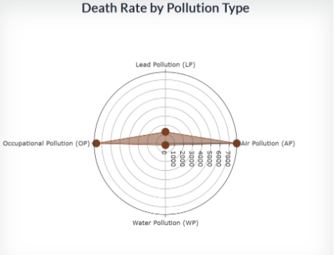
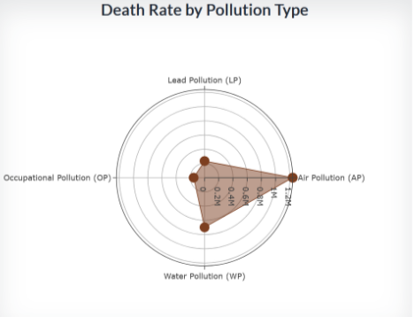
AQ POLLUTION MORTALITY DATA
CANADA
The analysis compares the causes of death due to different types of pollution with the impact of air pollution in the top 10 countries, with the goal of identifying any potential association between air pollution and mortality rates from different types of pollution in these countries.
The chart visualizes the number of deaths caused by Air Pollution vs other prevalent pollutions such as Lead, Water and Occupational pollutions
INDIA

Slide 13
Pollutants such as PM25, PM10, and NO2 allow scientists to estimate the spatial distribution of their ambient concentrations across different countries, quantifying air pollution and the burden of disease. These pollutants, in addition to other pollutants, vary across the globe and may result in different concentrations of air pollution from city to city, and country to country.
Conclusion
conclusion
Based on our analysis, it can be concluded that air pollution is among the top five factors contributing to mortality rates worldwide
Lastly, it can be deduced that similar age groups (i.e., under 5, 5-14, 15-49, 50-69, 70 plus) are affected similarly by air pollution in all countries across the globe.
STOP
POLLUTION
GO
GREEN
STOP
POLLUTION
GO
GREEN
However, there are many steps that individuals, organizations, and governments can take to reduce air pollution and its impacts. Some of these solutions include reducing our reliance on fossil fuels, transitioning to cleaner and more efficient transportation, and improving regulations on industrial emissions. By working together to address this issue, we can help to protect the air we breathe and create a healthier, more sustainable future for ourselves and future generations.
www.companyname.com

Slide 14




THANK YOU
FROM TEAM - 13
MARIVIC TANGUIN
Sameen SHAHZAD
Ali Taghipour
Farman syed
DATA ANALYST
DATA ANALYST
DATA ANALYST
DATA ANALYST

